Slide 1
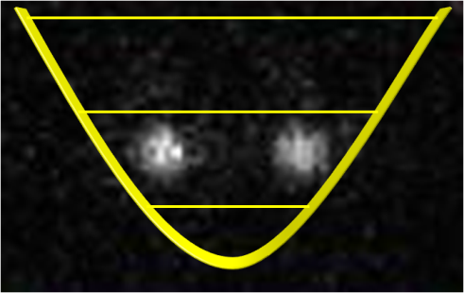

Slide 2
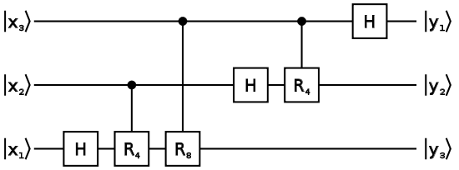
Pre-requisites for quantum computation
Collection of two-state quantum systems (qubits)
time
Initialise
qubit to
single state
Detect
qubit state
Operations which manipulate isolated qubits or pairs of qubits
Large scale device:
Transport information around processor/distribute entangled states
Perform operations accurately enough to achieve fault-tolerant error-correction
(accuracy ~ 0.9999 required)

Slide 3
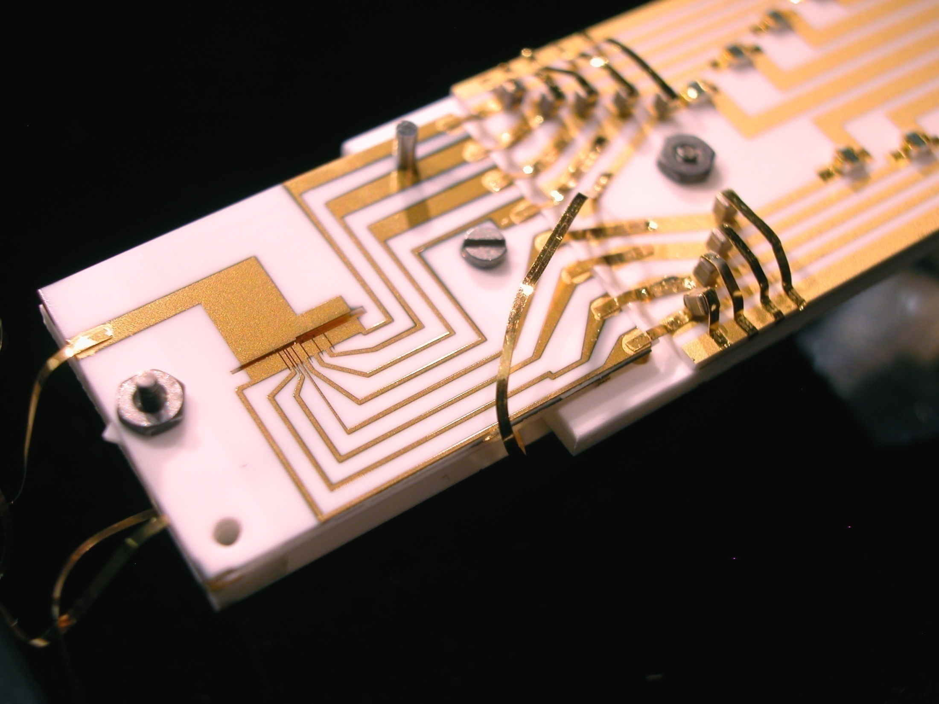
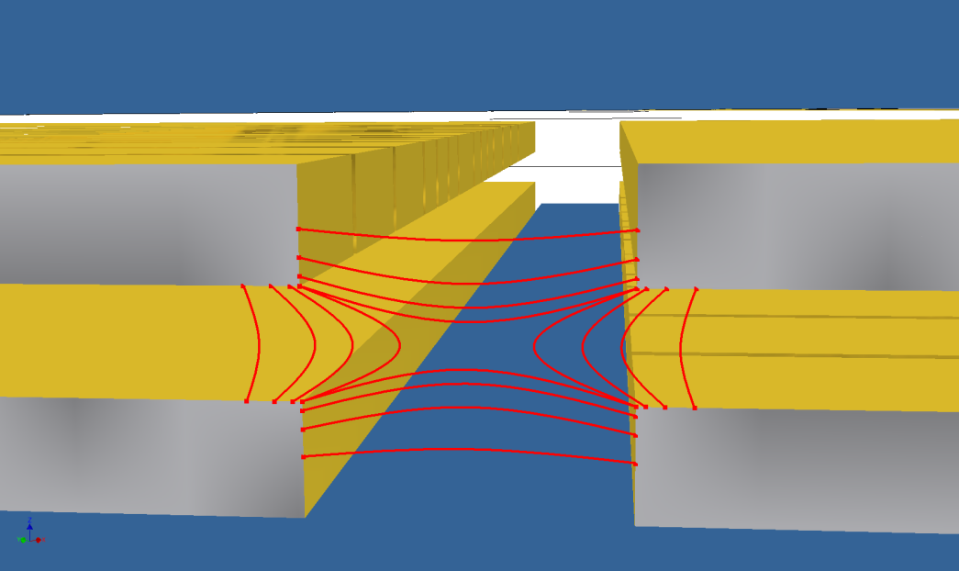
Ion trap
(NIST John Jost)
RF
DC
RF
RF ground
DC
RF
RF
RF ground

Slide 4
Isolating single charged atoms
Laplace‘s equation
– no chance to trap with static fields
Paul trap: Use a ponderomotive potential – change potential fast compared to speed of ion
Time average - Effective potential energy which is minimal at minimum E

Slide 5
Traps – traditional style
DC
RF
RF electrode
Axial potential gives almost ideal harmonic behaviour
n = 2
n = 1
n = 0

Slide 6
Multi-level atoms
⁴⁰Ca⁺ - fine structure
⁹Be⁺ - hyperfine structure
(16 Hyperfine states)

Slide 7
Requirement: long decay time for upper level.

Slide 8
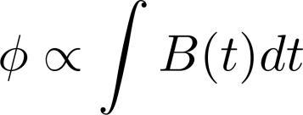
Storing qubits in an atom
- phase coherence
Problem: noise! – mainly from classical fields

Slide 9
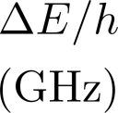
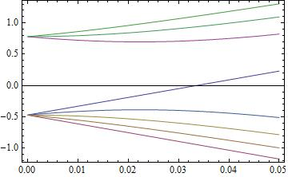
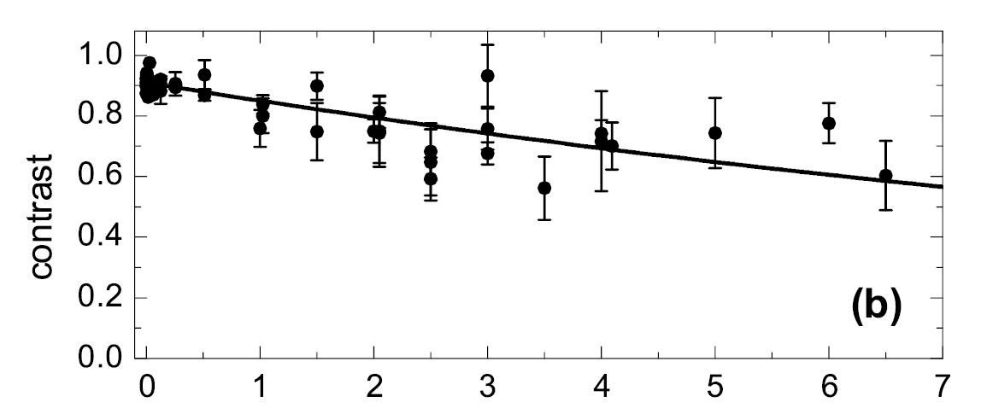
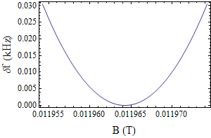
Storing qubits in an atom
Field-independent transitions
F = 1
119.645 Gauss
1 GHz
1207 MHz
F = 2
Time (seconds!)
Langer et al. PRL 95, 060502 (2005)

Slide 10
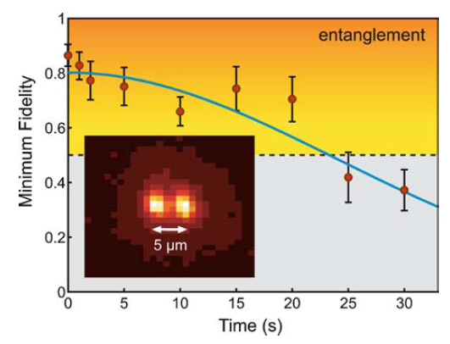
Entanglement for protection
Rejection of common-mode noise
Now consider entangled state
If noise is common mode, entangled states can have very long coherence times
Haffner et al., Appl. Phys. B 81, 151-153 (2005)

Slide 11
Preparing the states of ions
Optical pumping – state initialisation
Use a dipole transition for speed
Example: calcium
Calcium: scatter around 3 photons to prepare

Slide 12
Reading out the quantum state
Imaging
system
Photon scattered every 7 ns
BUT
we only collect a small fraction of these
Need to scatter 1000 photons to detect atom

Slide 13
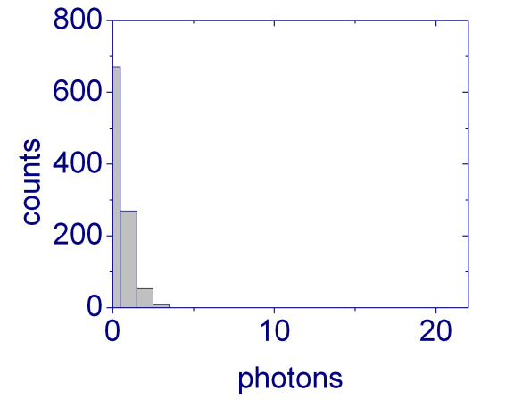
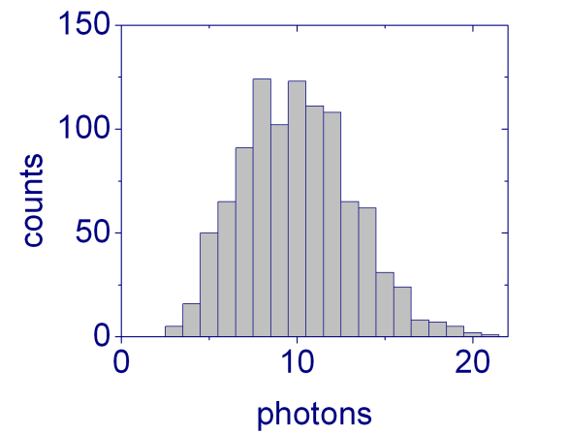
Measurement – experiment sequence
Initialise
Manipulate
Detect
How many photons?
Statistics: repeat the experiment many (1000) times
Number of photons = 8, 4, 2, 0, 0, 1, 5, 0, 0, 8 ….

Slide 14
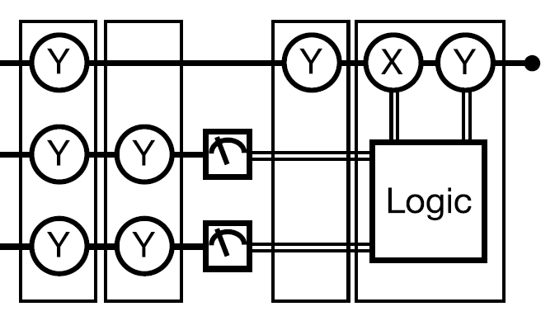
Single shot measurement
“Realization of quantum error-correction“, Chiaverini et al., Nature 432, 602, (2004)
Target
Classical processing
“If you get 1, 0, do Y, else do X“
Ancilla
Ancilla
Measurement: “8 counts, this qubit is 1!“
Accuracy of 0.9999 achieved in 150 microseconds
Myerson et al. Phys. Rev. Lett. 100, 200502, (2008)

Slide 15
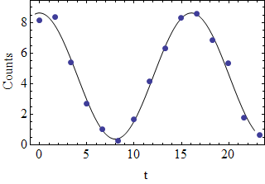
Manipulating single qubits
Laser-driven,
quadrupole
Resonant microwaves,
hyperfine
Counts
Raman transition,
hyperfine

Slide 16
Addressing individual qubits
Intensity addressing
Frequency addressing
Shine laser beam at one ion in string
Image: Roee Ozeri
2-4 μm
Separate ions by a distance much larger than
laser beam size
240 μm

Slide 17
Multiple qubits: interactions

Slide 18
Multiple ions: coupled harmonic oscillators
Expand about equilibrium – equation of motion
Independent oscillators
- shared motion

Slide 19
The original thought
Cirac and Zoller, PRL (1995)
“The collective oscillator is a quantum bus“

Slide 20
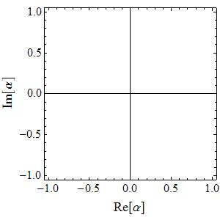
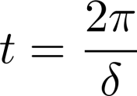
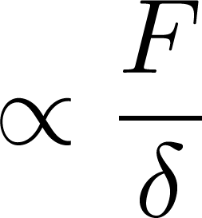
The forced harmonic oscillator
Classical forced oscillator
“returns“ after
Radius of loop

Slide 21
Forced quantum oscillators
Transient excitation, phase acquired

Slide 22
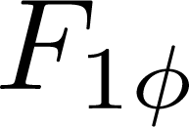
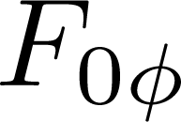
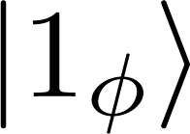
State-dependent excitation

Slide 23
Two-qubit gate, state-dependent excitation
Force is out of phase; excite Stretch mode
Force is in-phase; excite COM mode

Slide 24
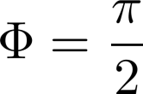
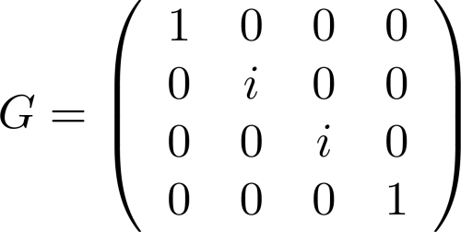
Examples: quantum computing
Choose the duration and power:
Universal two-qubit ion trap quantum processor: Hanneke et al. Nature Physics 6, 13-16 (2010)

Slide 25
Laser-driven multi-qubit gates
basis, polarisation standing wave
basis, interference effect
Leibfried et al. Nature 422, 412-415 (2003)
F
F
F
F

Slide 26
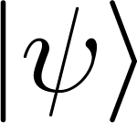
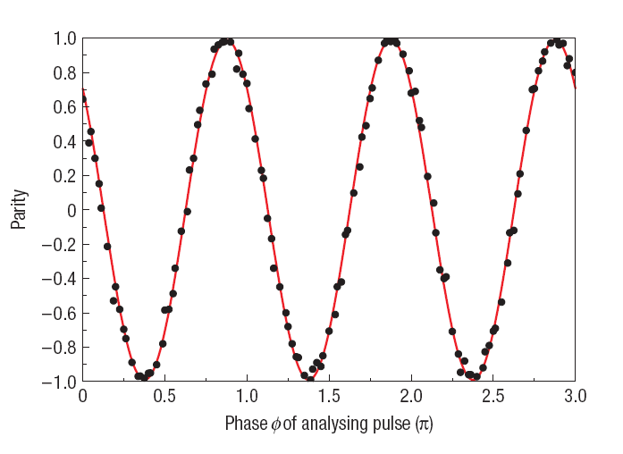
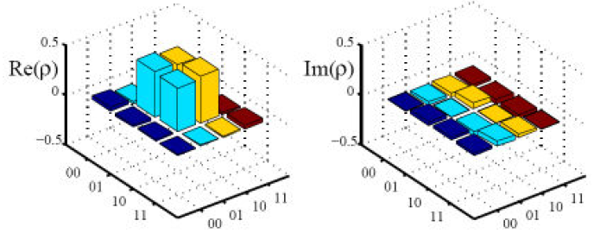
State and entanglement characterisation
8, 6, 7, 4, 9, 0, 0, 1, 1, 6, 1, 9, 0, 0…
Detect
5, 4, 3,11, 4, 1, 0, 0, 1, 8, 0, 8, 1, 0…
Entanglement – correlations…
Choose 12 different settings of
Qubits in the
same state
Reconstruct density matrix
Qubits in
different states
F = 0.993 (Innsbruck)
Benhelm et al. Nat. Phys 4, 463(2008)

Slide 27
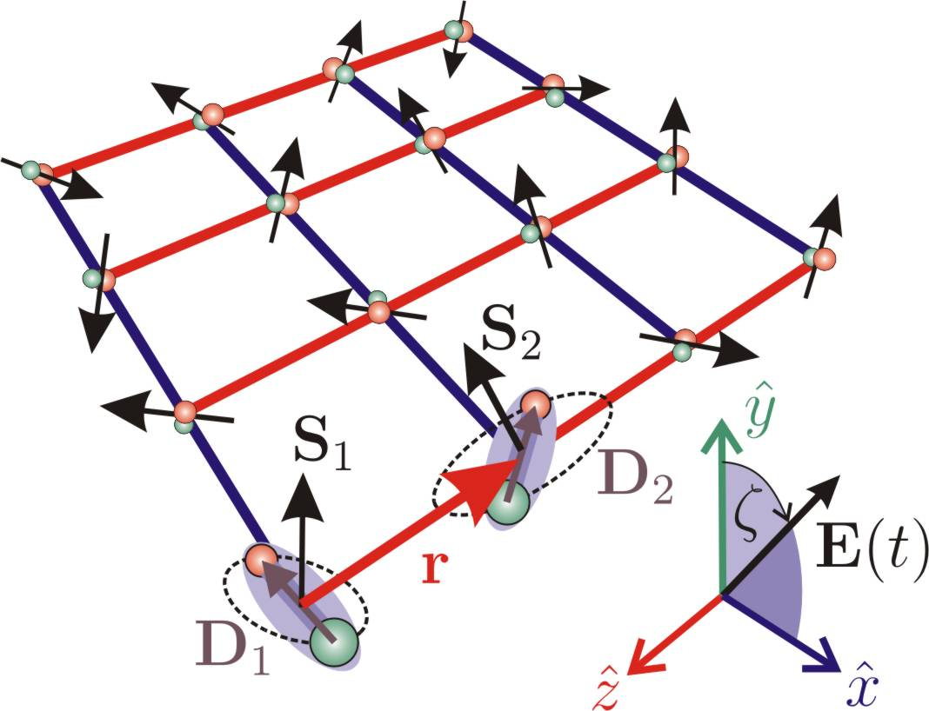
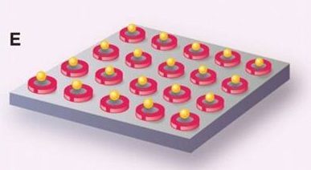
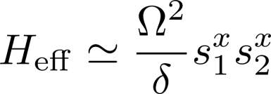
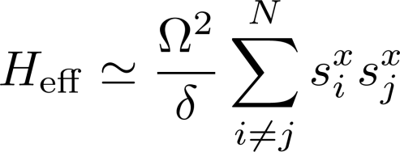
Quantum simulation with trapped-ions
Creation of “condensed-matter“ Hamiltonians
(Friedenauer et al. Nat. Phys 4, 757-761 (2008)
Kim et al. Nature 465, 7298 (2010))
Go to limit of large motional detuning
(very little entanglement between spin and motion)

Slide 28
Dealing with large numbers of ions
Technical requirement
Limitation
Spectral mode addressing
Mode density increases
Many ions
Heating rates proportional to N
Simultaneous laser addressing
Ions take up space (separation > 2 micron)
Laser beams are finite-size

Slide 29
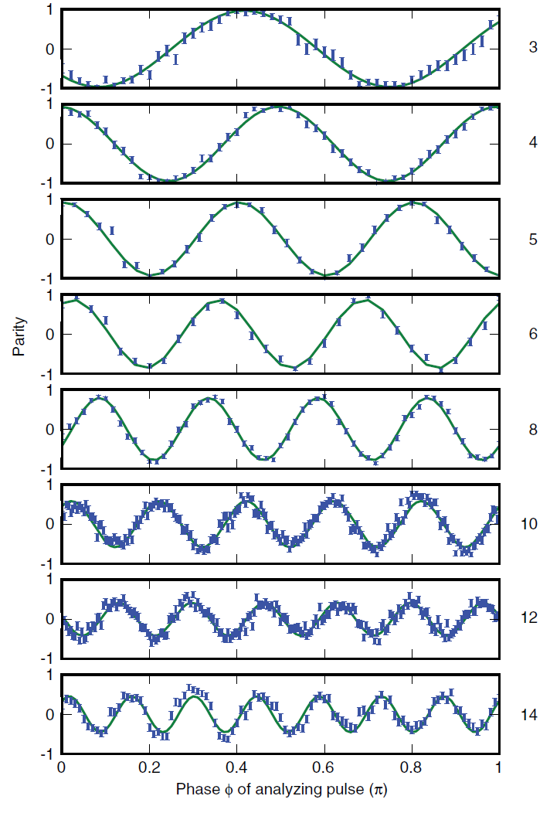
Entanglement of multiple ions
Monz et al., PRL 106, 130506 (2011)
High contrast – 3 ions
Reduced contrast – 14 ions

Slide 30
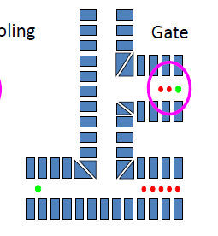
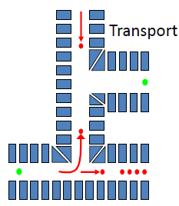
Isolate small numbers of ions
Wineland et al. J. Res. Nat. Inst. St. Tech, (1998)
“coolant“ ion
Technological challenge – large numbers of electrodes, many control regions

Slide 31
Distributing entanglement: probabilistic
"Click"
"Click"
50/50 beamsplitter
Entangled ions separated by 1m ( Moehring et al. Nature 449, 68 (2008) )

Slide 32
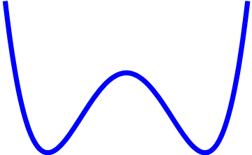
Transport with ions
240 μm
Move: 20 us, Separate 340 us, 0.5 quanta/separation
Internal quantum states of ions unaffected by transport
Motional states are affected – can be re-initialised
Total transport distance = 1 mm
Zone A
Separation
Zone B
10 ms
J .P. Home et al. Science 325, 1228 (2010)

Slide 33
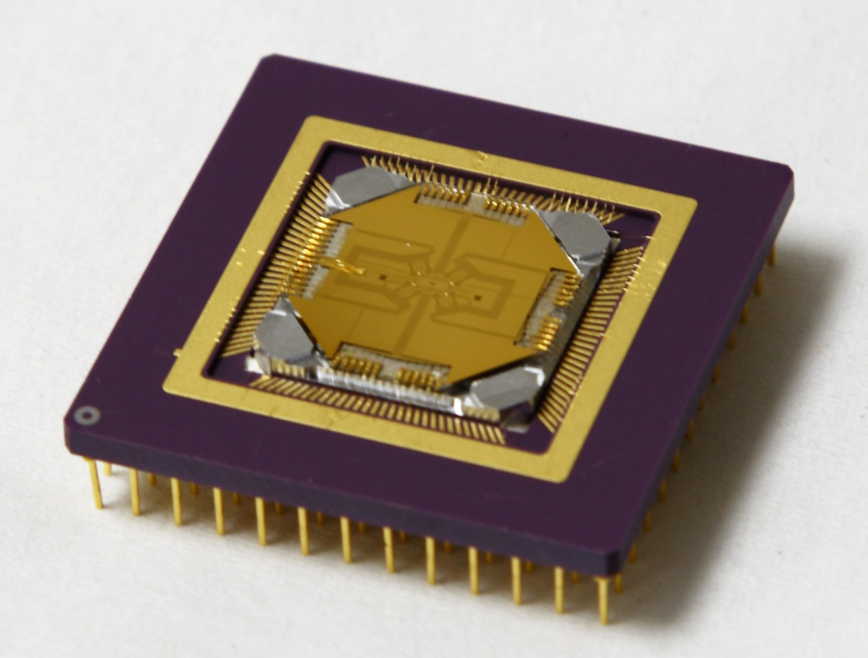
Trapping ions on a chip
For microfabrication purposes, desirable to deposit trap structures on a surface
(Chiaverini et al., Quant. Inf. & Computation (2005), Seidelin et al. PRL 96, 253003 (2006))
end view of
quadrupole
electrodes
Field lines:
trap axis
Challenges: shallow trap depth (100 meV)
charging of electrodes
Opportunities: high gradients
RF electrodes
Control electrodes

Slide 34
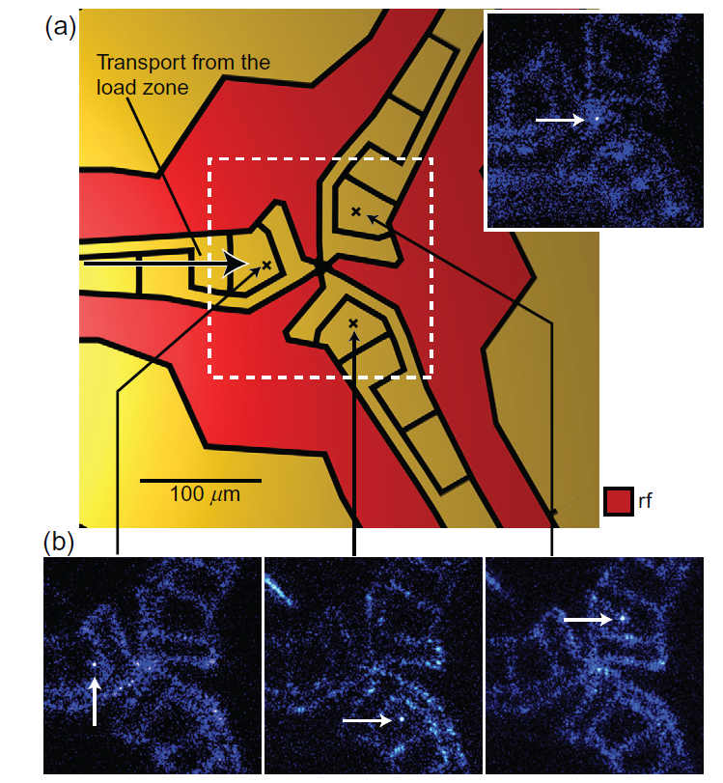
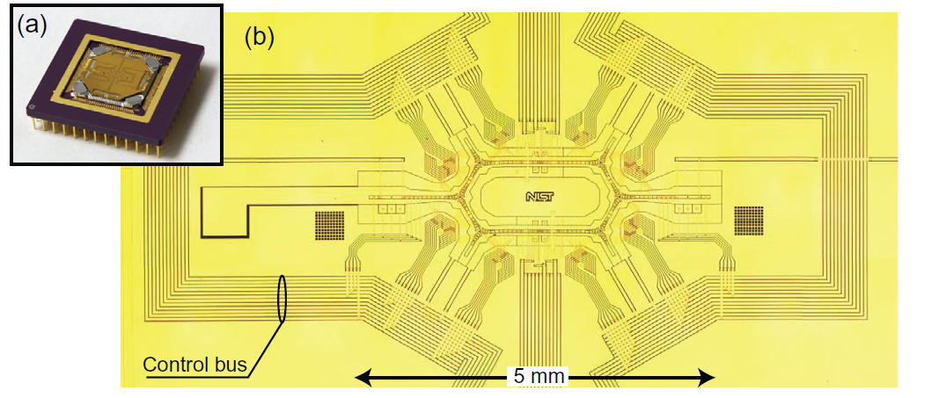
Transporting ions on a (complicated) chip
J. Amini et al. New. J. Phys 12, 033031 (2010)

Slide 35
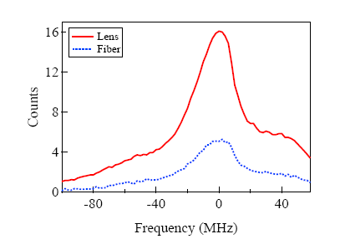
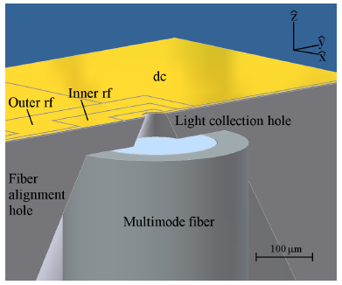
Integrated components 1
Vandevender et al. PRL 105, 023001 (2010)

Slide 36
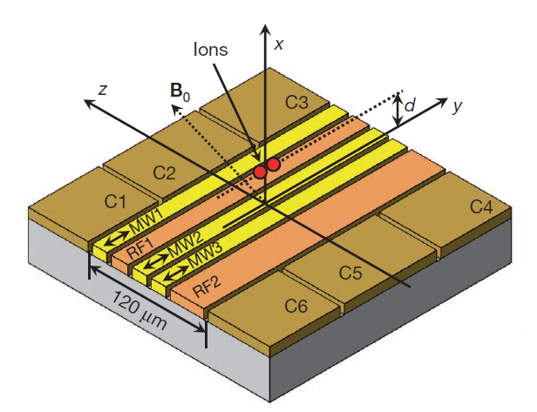
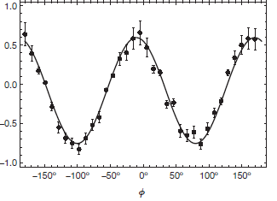
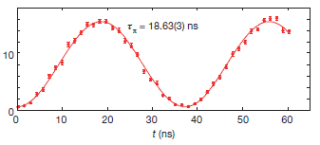
Integrated components
eg. Quantum control using microwaves – removes the need for high-power lasers
Gradients – produce
state-dependent
potentials through
Zeeman shifts
Single-qubit gate
2-qubit gate
C. Ospelkaus et al. Nature 182, 476 (2011)

Slide 37
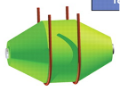
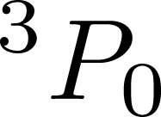
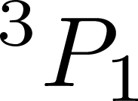
Trapped-ions and optical clocks
e.g. Rosenband et al., Science 319, 1808 (2008)
Frequency standards
Aluminium ion
Laser
167 nm
267 nm
Require very stable ion transition
Has a very stable transition
BUT 167 nm is vacuum UV

Slide 38
Atomic clocks – quantum logic readout
Shared motion
Beryllium
Cooling and readout ion
Aluminium “Clock” ion:
“Allowed” (scatter
lots of photons)
Most accurate and precise frequency standards – 8e-18 fractional uncertainty
(Chou et al. PRL 104, 070802 (2010))

Slide 39
Trapped-ion summary
Have achieved quantum control
of up to N ions
Have demonstrated all basic components required
to create large scale entangled states
Algorithms & gates
include Dense-coding, error-correction,
Toffoli, Teleportation, Entanglement purification
Entanglment swapping
Working on:
Higher precision
New manipulation methods
Scaling to many ions

